Slide 1

Global Seismic Risk Profiler
End-to-End Data Engineering Pipeline on Microsoft Fabric
By Mrudula Kamdi
Notes:
1

Slide 2

The Challenge: Transforming Noise into Insight
Earthquake risk is a critical financial metric for insurance companies and urban planners. Raw seismic telemetry from the USGS API is highly detailed but too granular for decision-making.
Granularity
Data Quality
Individual events don't reveal long-term trends
Raw feeds contain duplicates, nulls, and schema mismatches
Business Readiness
Analysts need risk tiles and severity scores, not raw JSON logs
Notes:
2

Slide 3
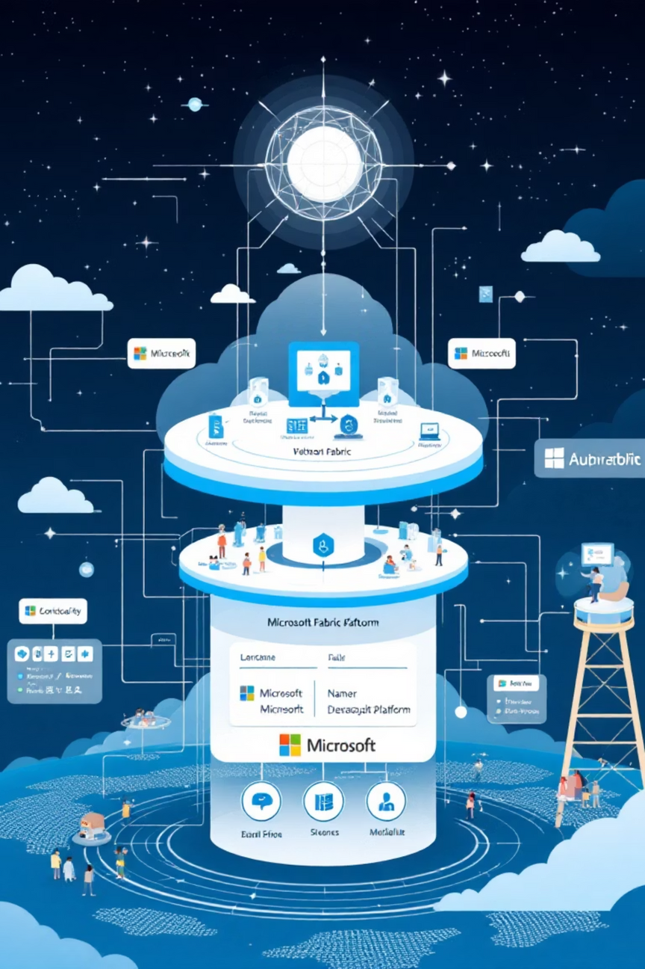
Modern Medallion Architecture on Microsoft Fabric
Tech Stack
Data Flow
Orchestration: Data Factory
API → Bronze (Raw) → Silver (Cleaned) → Gold (Aggregated Risk Models) → Dashboard
Compute: Spark (Python) & T-SQL
Storage: OneLake (Bronze/Silver/Gold)
Serving: Power BI
Notes:
3

Slide 4





Ensuring Data Integrity
Bronze Layer
Raw ingestion for traceability.
Silver Layer
Cleaning, schema enforcement, deduplication
Gold Layer
Risk scoring, severity classification, geospatial aggregation
Notes:
4

Slide 5
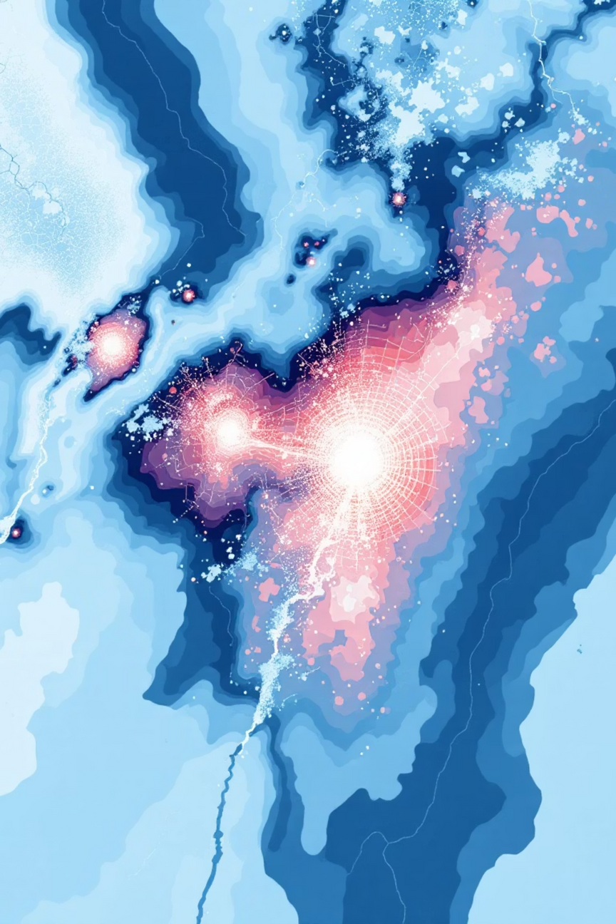
Engineering Business Value
Traffic Light Logic
Spatial Binning
Implemented regulatory classification to tag events based on impact:
Problem: Mapping millions of points crashes dashboards.
Solution: Aggregated data into 1x1 degree geospatial tiles.
Micro (Low)
Moderate (Medium)
Result: Enabled heat-map visualization of high-density risk zones.
Strong (High)
Notes:
5

Slide 6





Earthquake Risk Explorer Dashboard
Decision Support System
High-Significance Monitor
Bubble size relative to maximum significance highlights critical events immediately
Risk Categorization
Visual legend distinguishing high vs. low risk events
Temporal Filtering
Date range sliders to analyze specific event windows
Global Coverage
Visualizing events across major fault lines in North America, Asia, and Europe
Notes:
6

Slide 7

From Data to Decisions
90%
1
100%
Reduced Noise
Single Source of Truth
Actionable Insights
Filtered out low-impact micro-tremors using significance threshold
Standardized reporting for seismic risk using the Gold Layer
Enabled insurers to identify high-risk zones for premium adjustment
Notes:
7

